Slide 1
Analog Circuits and Systems
Prof. K Radhakrishna Rao
Lecture 11: Feedback in Systems

Slide 2
Previous lecture
Applications of multipliers and comparators
Macro models of BJTs and FETs
Realizations of voltage buffer, current buffer, trans-conductance amplifier and trans-resistance amplifiers using nullator-norator models of transistors

Slide 3
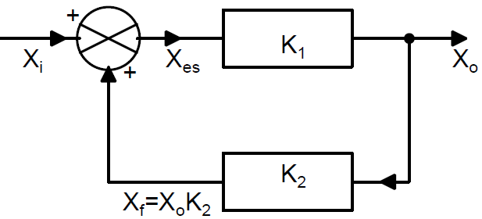
What is Feedback?
Dynamic system with feedback
K₁ represents the forward path of the system
K₂ represents the feedback path of the system
K₁ and K₂ are unilateral (transmission from input to output only)
X_{i} is the input variable and is X_{o} the output variable

Slide 4
What is Feedback? (contd.,)

Slide 5
What is Feedback? (contd.,)

Slide 6
Negative Feedback System

Slide 7
Positive Feedback System

Slide 8
Sensitivity in Negative Feedback Systems

Slide 9
Sensitivity in Negative Feedback Systems

Slide 10
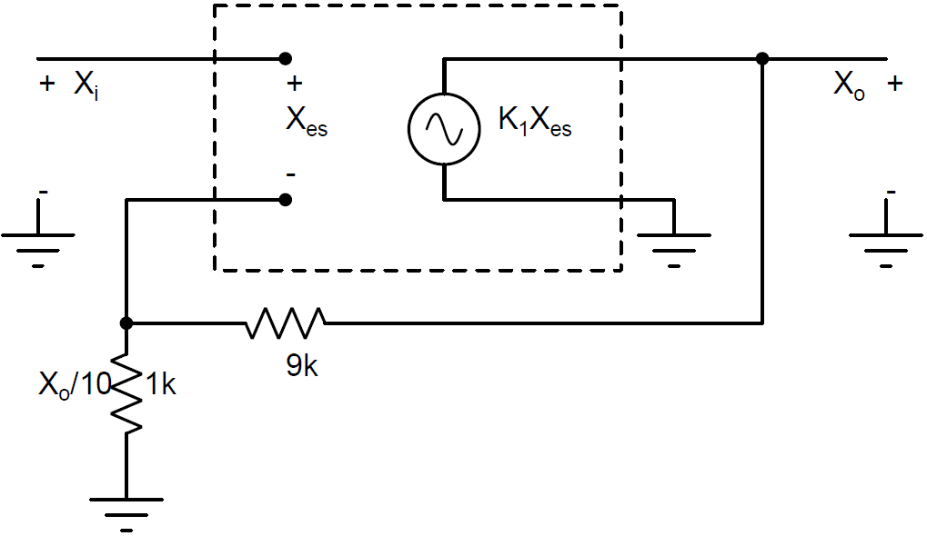
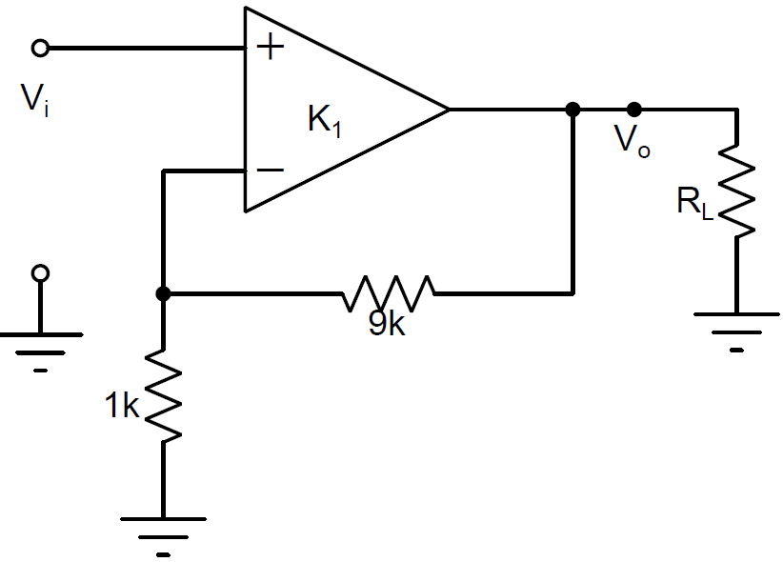
Example: Sensitivity and Negative Feedback
Voltage Amplifier

Slide 11
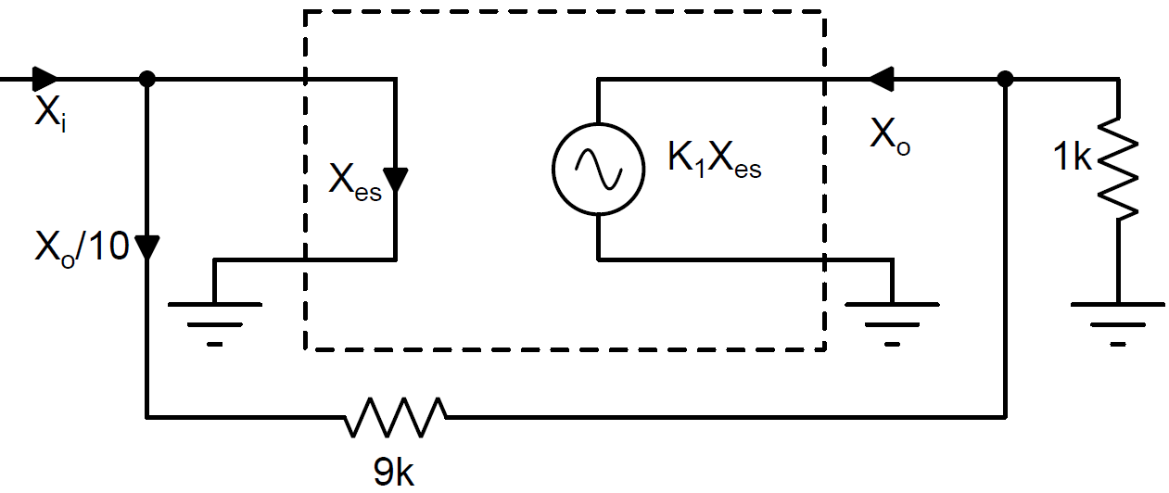
Example: Sensitivity and Negative Feedback
Voltage Amplifier

Slide 12
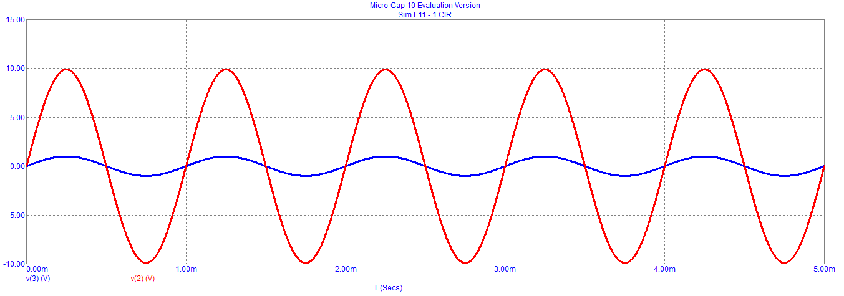
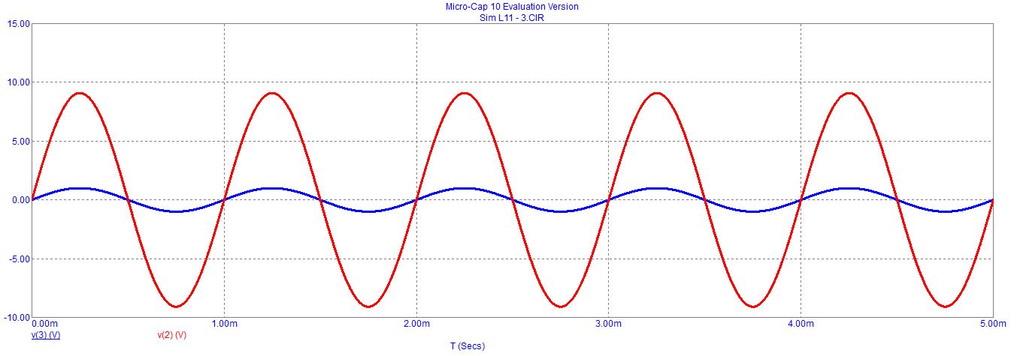
Simulation: Voltage Amplifier
G_{L}=- 100
G_{L}= -10

Slide 13
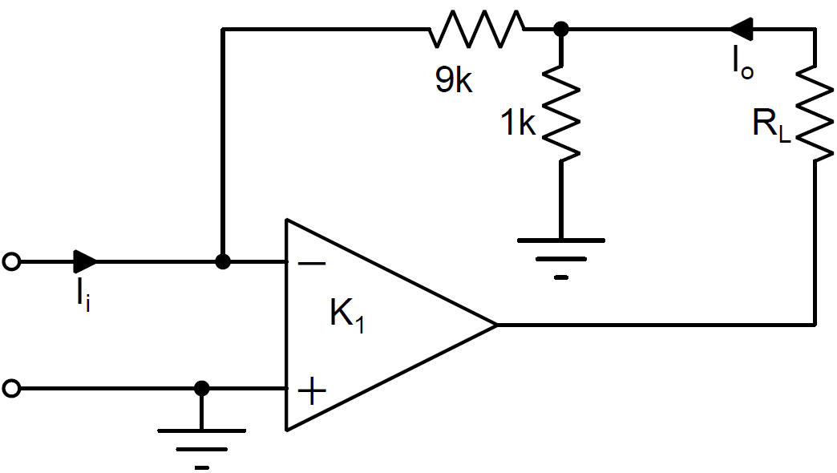
Example: Sensitivity and Negative Feedback
Current Amplifier

Slide 14
Current Amplifier

Slide 15
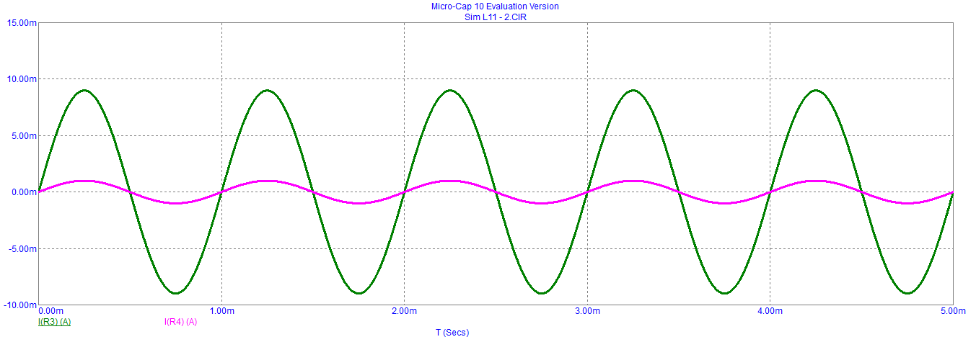

Simulation: Current Amplifier
G_{L}=- 100
G_{L}= -10

Slide 16
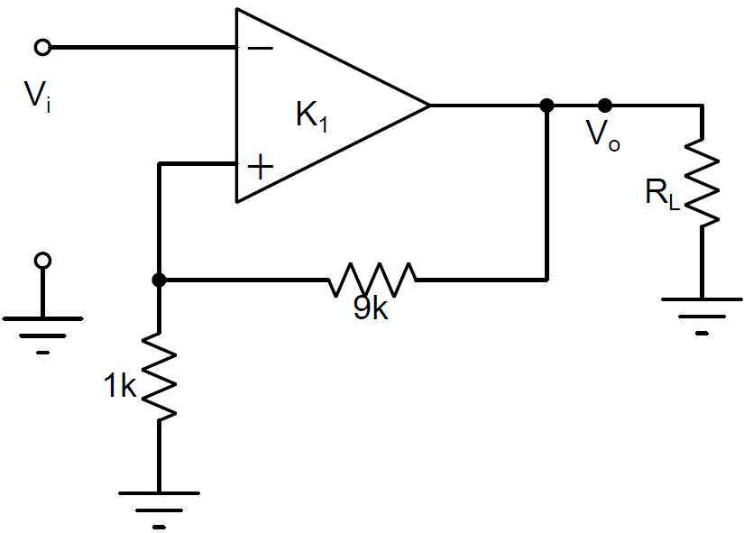
Sensitivity and Positive Feedback

Slide 17
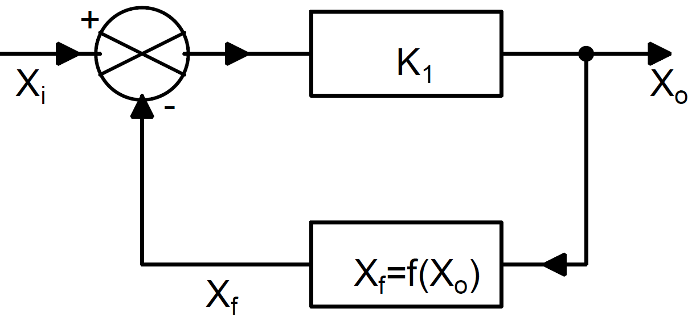
Non-linear Feedback

Slide 18
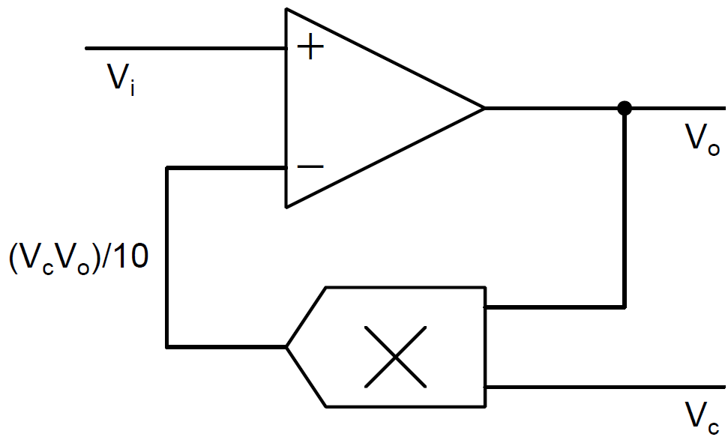
Example: Negative Feedback and Inversion
Multiplier in feedback path results in a divider

Slide 19
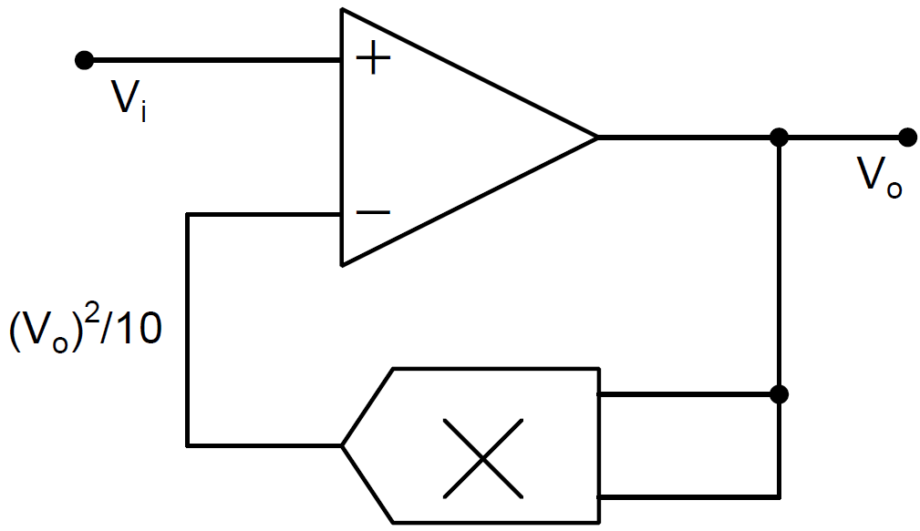
Example: Negative Feedback and Inversion
Squarer in the feedback path results in a square rooter

Slide 20
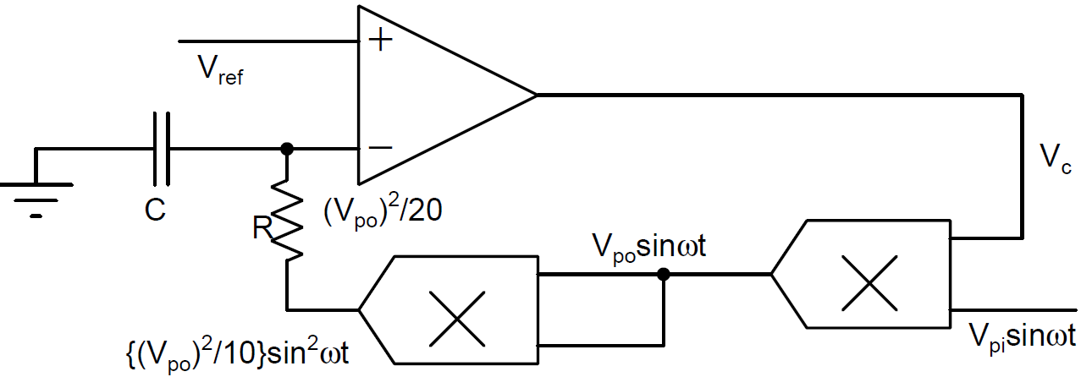
Example: Negative Feedback and Inversion
Square rooter through squarer

Slide 21
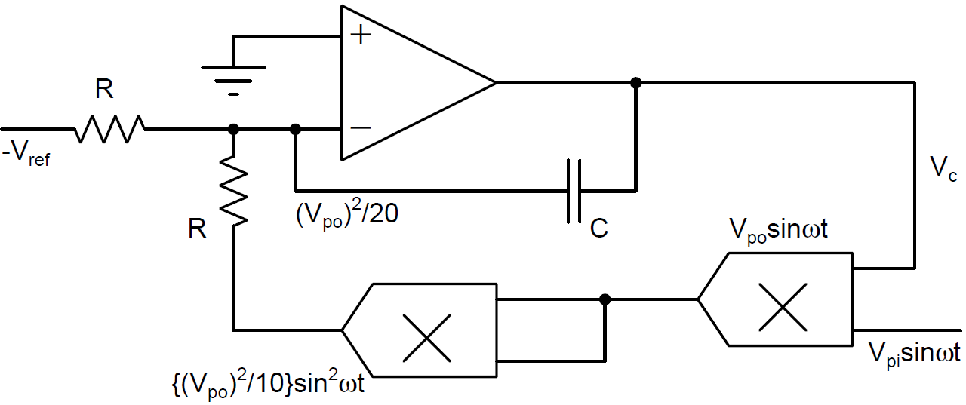
Example: Negative Feedback and Inversion

Slide 22
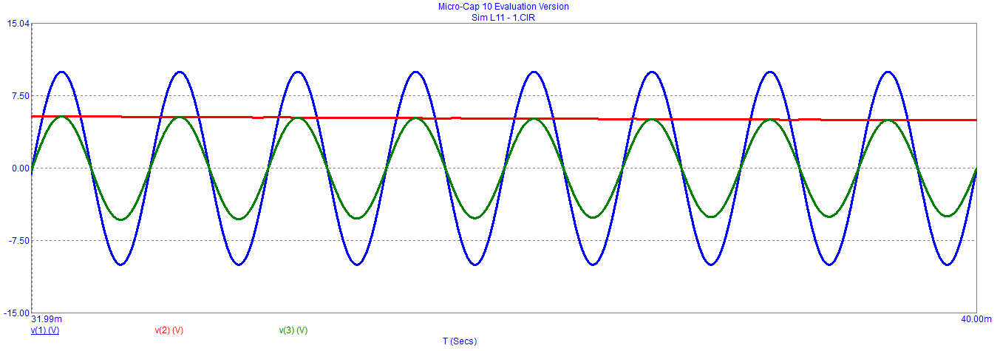
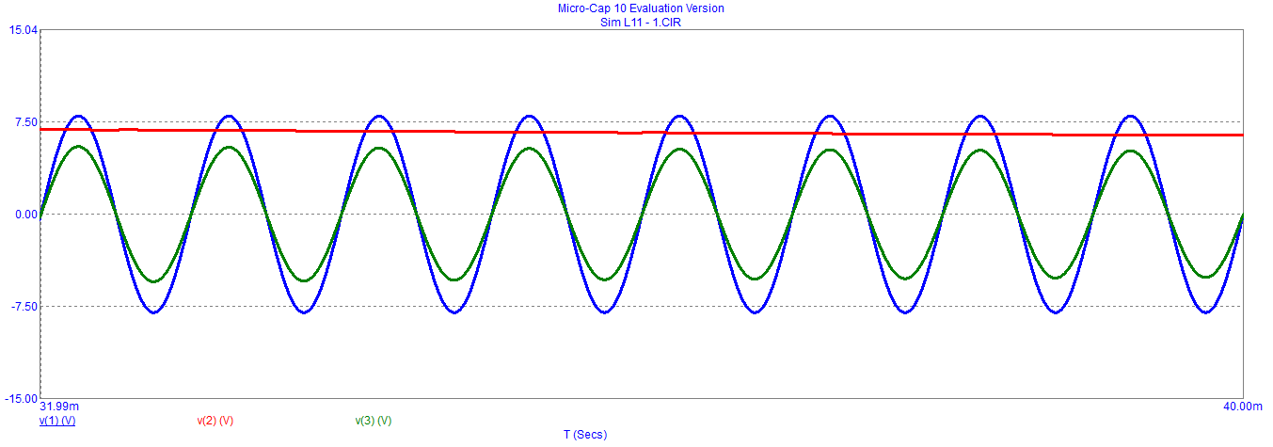
Simulation with V_{ref} = 0.8 and V_{po}= 4 volts
V_{pi} = 10
V_{pi} = 8

Slide 23
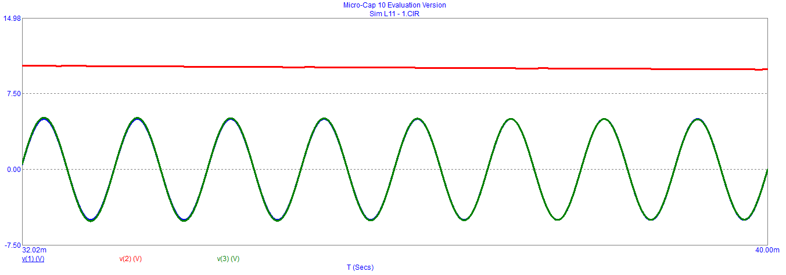
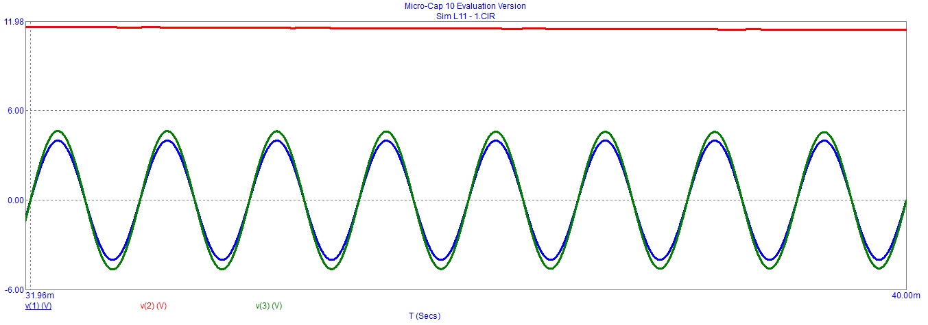
Simulation with V_{ref} = 0.8 and V_{po}= 4 volts
V_{pi} = 5
V_{pi} = 4

Slide 24
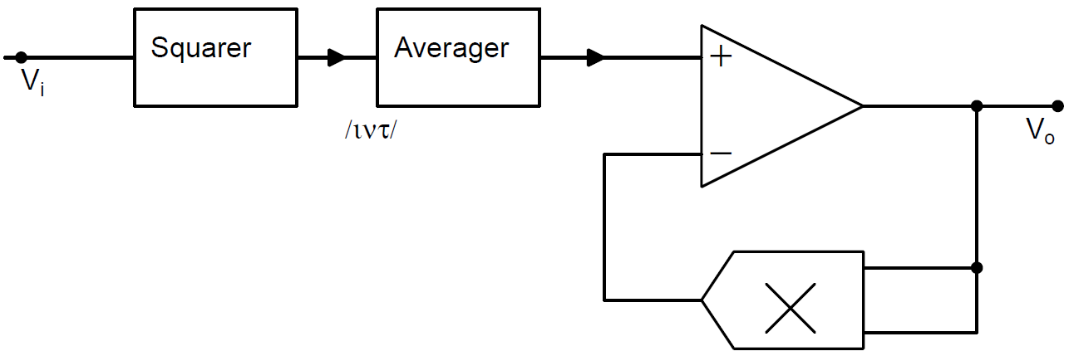
Example: Negative Feedback and Inversion
True RMS Generator
True RMS value of any periodic waveform can be generated using squarer, averages (low pass filter and a square rooter)

Slide 25
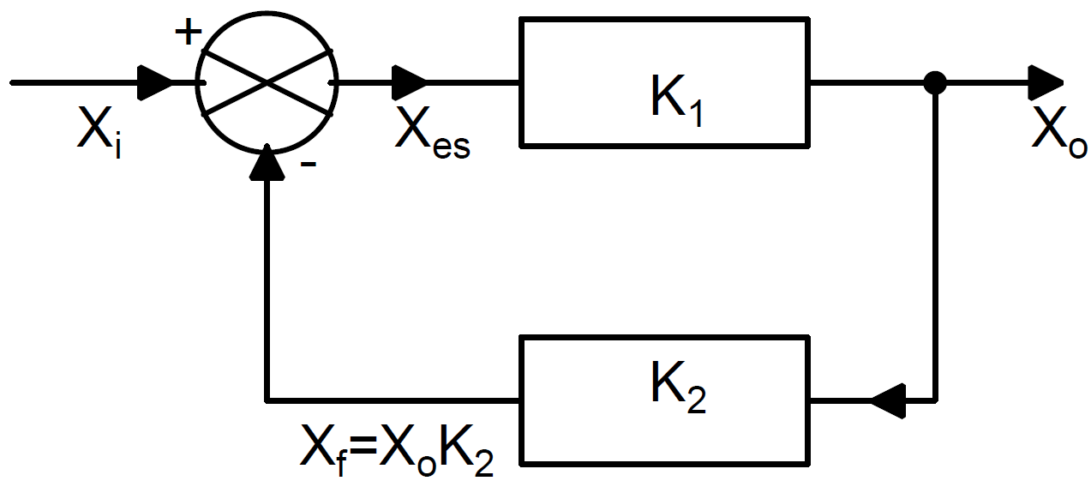
Feedback System
K₁ is the forward path of the system
K₂ is the feedback path
X_{f} follows the input X_{i} precisely if the loop gain G_{L} is very large

Slide 26
Encoder-Decoder Feedback System
Feedback systems with
K₁ as an encoder then K₂ as a decoder, and vice-versa
Input variable to K₁ is of the same dimension as that of output variable of K₂, and input variable K₂ is of the same dimension as that of output variable of K₁
Enables realization of a large number of communication functions

Slide 27
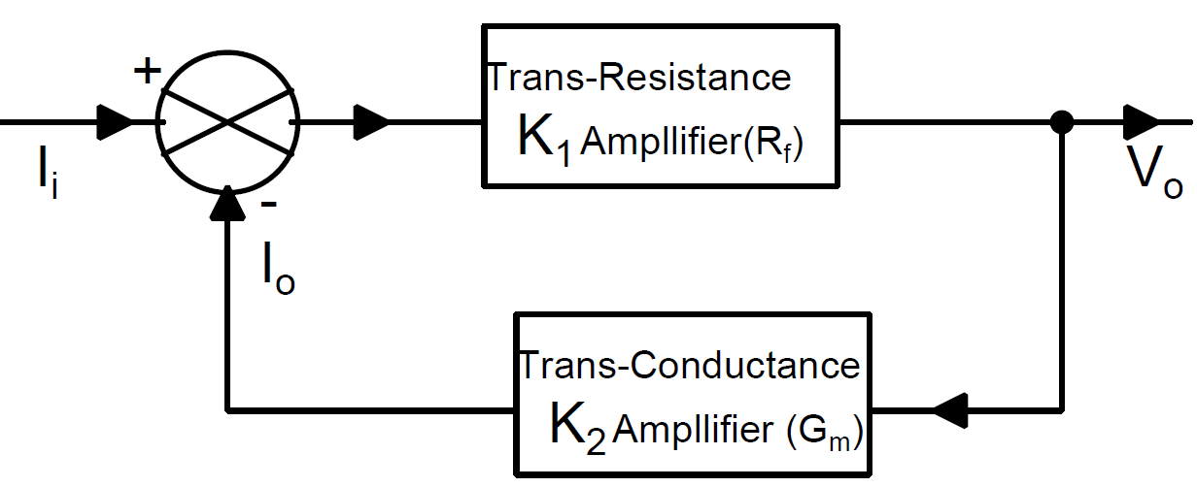
Current-to-Voltage Converter and Current Follower
K₁ is Trans-resistance (R_{f}) amplifier and K₂ is Trans-conductance (G_{m}) amplifier
The loop gain G_{m}R_{f} >> 1

Slide 28
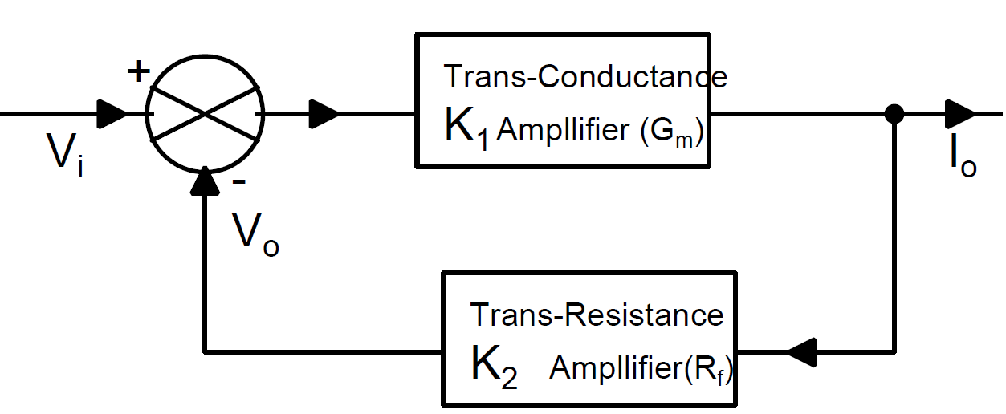
Voltage-to-Current Converter and Voltage Follower
K₁ is Trans-conductance (G_{m}) amplifier and K₂ is Trans-resistance (R_{f}) amplifier
The loop gain G_{m}R_{f} >> 1

Slide 29
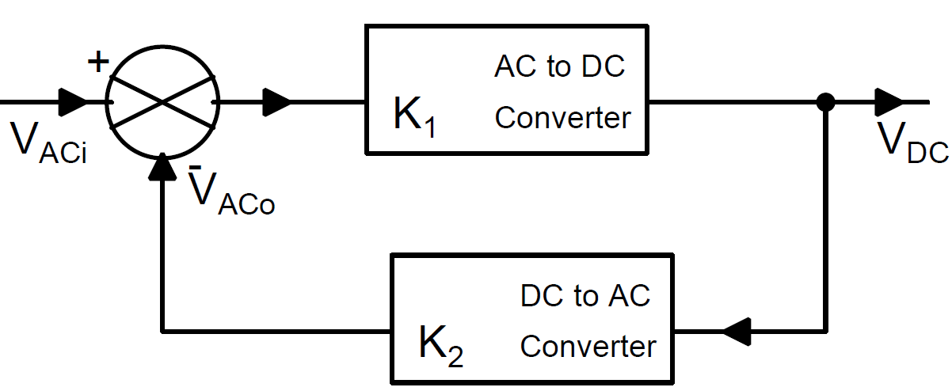
AC to DC converter and AC Follower
K₁ is AC to DC converter and K₂ is DC to AC converter
The loop gain G_{L} >> 1

Slide 30
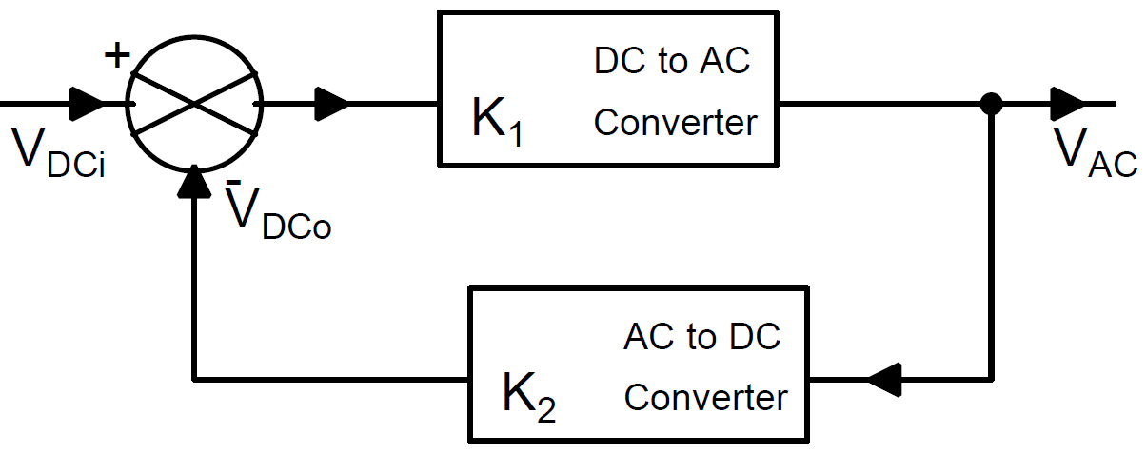
DC to AC Converter and DC Follower
K₁ is DC to AC converter and K₂ is AC to DC converter

Slide 31
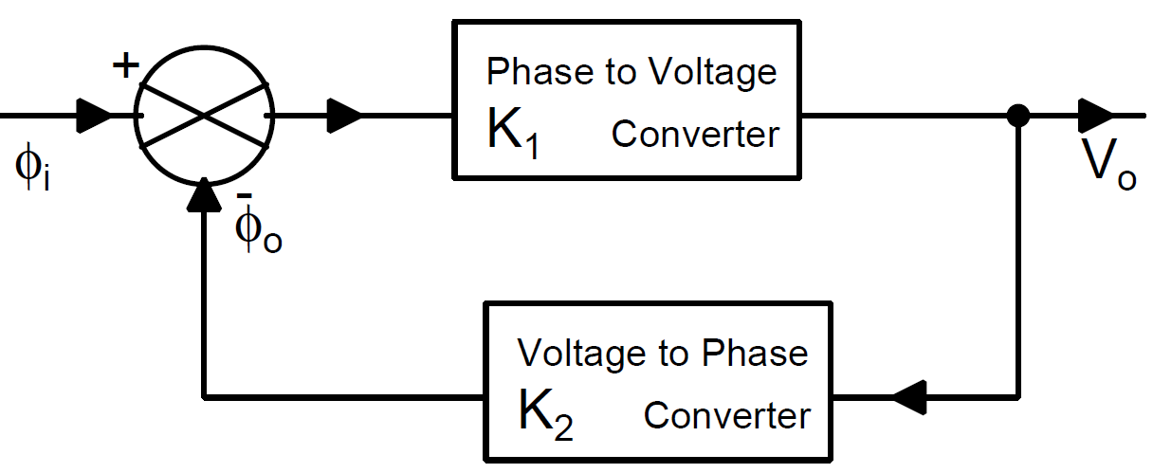
Phase to Voltage Converter and Phase Follower
K₁ is Phase to Voltage converter and K₂ is Voltage to Phase converter

Slide 32
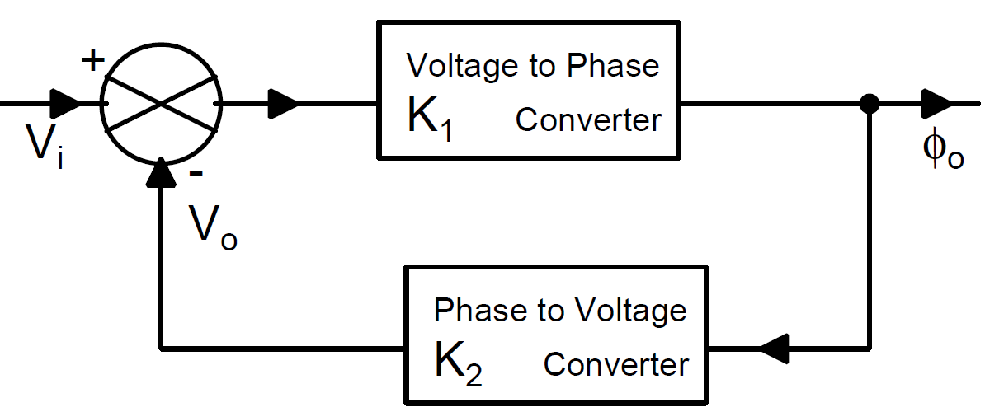
Voltage to Phase Converter and Voltage Follower
K₁ is Voltage to Phase converter and K₂ is Phase to Voltage converter

Slide 33
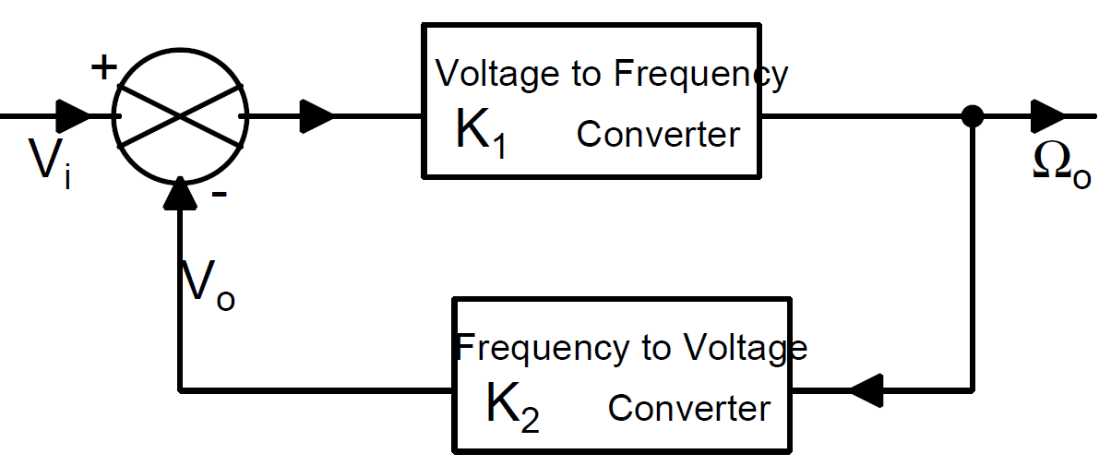
Voltage to Frequency Converter and Voltage Follower
K₁ is Voltage to Frequency converter and K₂ is Frequency to Voltage converter

Slide 34
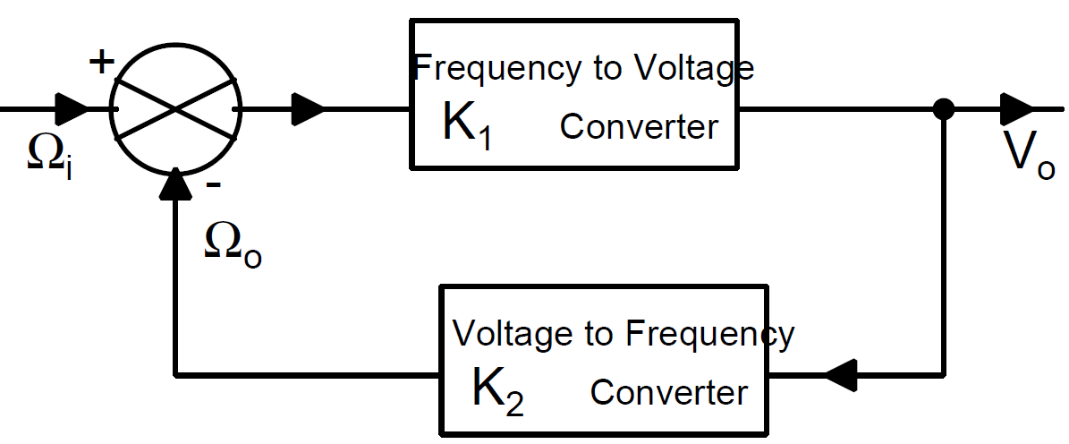
Frequency to Voltage Converter and Frequency Follower
Frequency Follower and FM Detector
K₁ is Frequency to Voltage converter and K₂ is Voltage to Frequency converter

Slide 35
Frequency Locked Loop

Slide 36
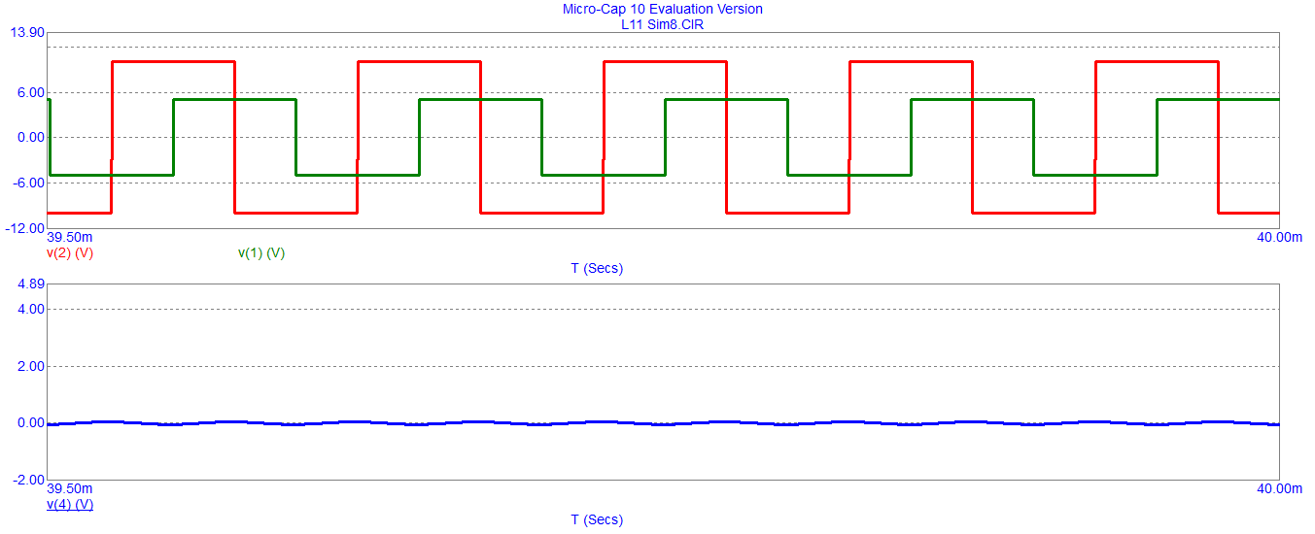
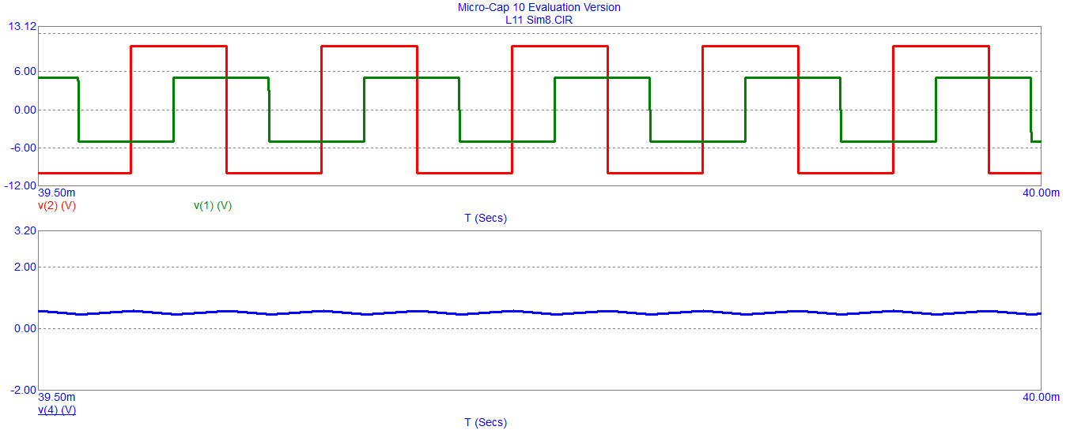
Simulation: Quiescent frequency = 10kHz for V_{cq}=0 V
T = 0.1 ms
T = 0.095 ms

Slide 37
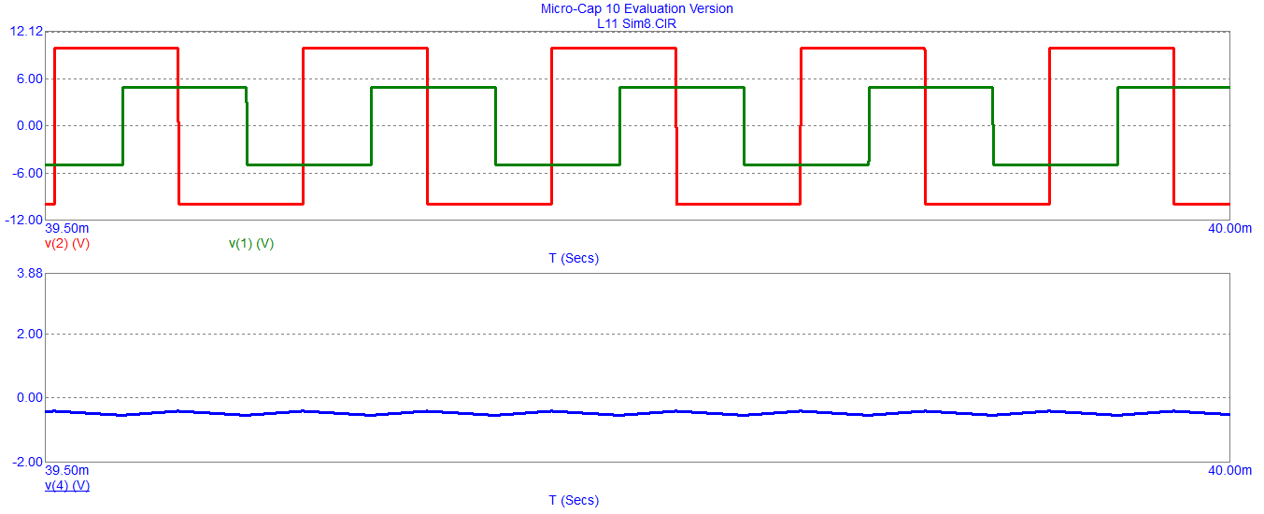
Simulation: Quiescent frequency = 10kHz for V_{cq}=0 V
T = 0.105 ms

Slide 38
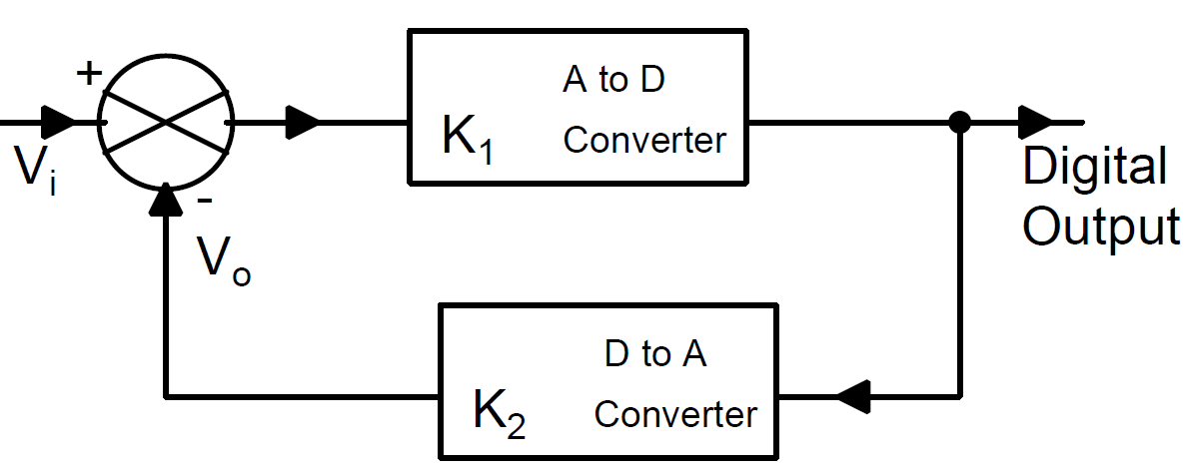
A to D Converter Analog Voltage Follower
K₁ is A to D Converter and K₂ is D to A Converter

Slide 39
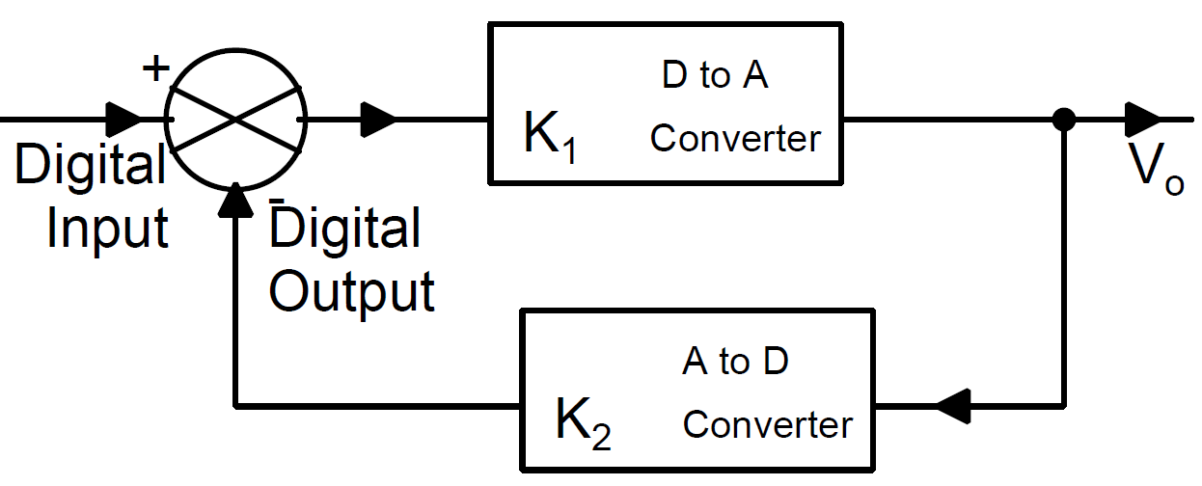
D to A Converter Digital Follower
K₁ is D to A Converter and K₂ is A to D Converter

Slide 40
Conclusion
Negative feedback makes the output less sensitive or insensitive to the variations of parameters associated with active devices in the forward path
Negative feedback makes the output sensitive to parameter variations associated with the feedback path
Positive feedback can make the output very sensitive to parameter variations associated with the loop
Encoder-Decoder feedback systems enable us to realize a wide range of analog signal processing functions

